Slide 1
COMP5200M MSc Project 23/24
Process and Getting Started

Slide 2
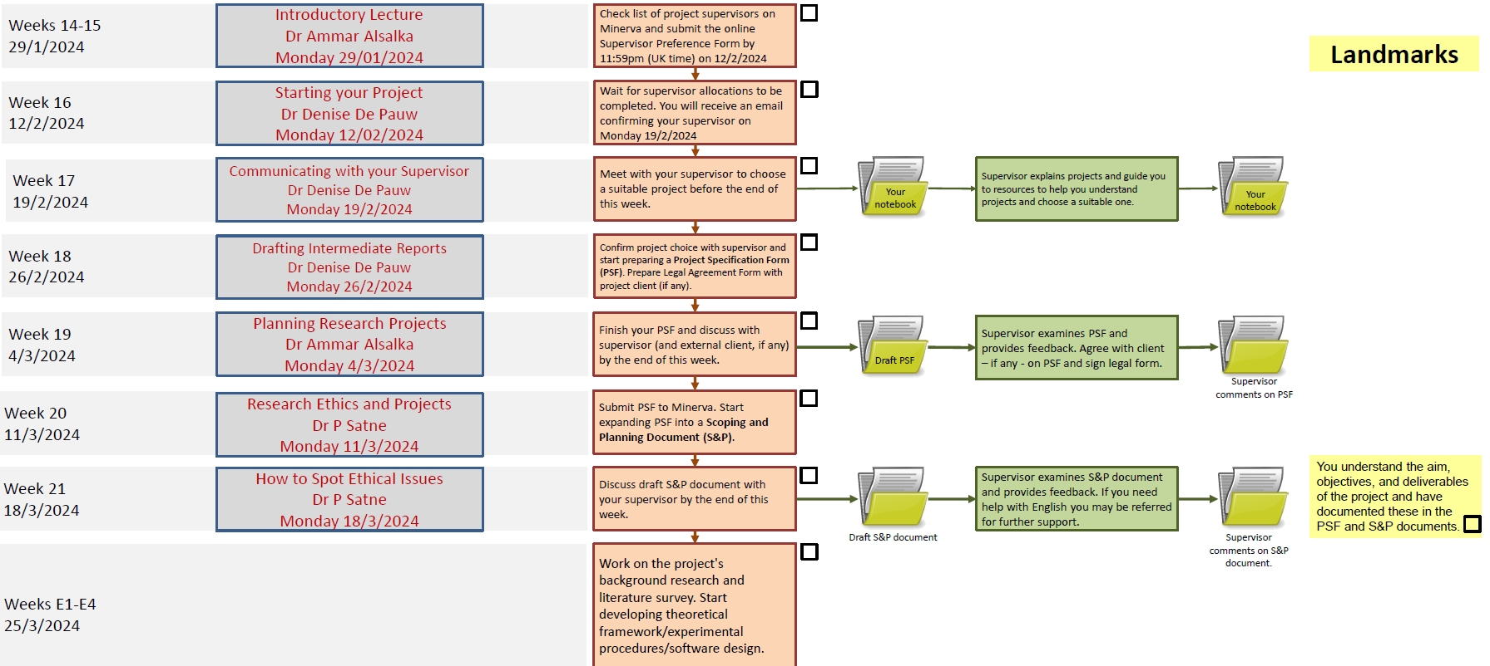
Next steps

Slide 3
Next steps
For next week:
Project specification form (title, supervisor, type of project)
Complete and submit the project specification form
For the next month:
Background reading (what is the problem I am trying to solve?)
Scoping the project (what will it be about exactly?)
Aims and objectives (what will I achieve at the end?)

Slide 4
Tentative topics/titles
Student | Tentative topics
Olanrewaju Sodeinde
Zhang Wenjie | Machine learning classification of aneurysms using imaging and simulation data
Gao Hongwei
Ziwen Lu

Slide 5
Typical aims & objectives
Aims: "Investigate the solution of a problem X using a specific type of algorithm Y. This is important because problem X is known to be…"
Objectives:
(Stage 1)
1. Gain access to and pre-process imaging data set Z.
2. Review literature related to problem X and find candidates for algorithm Y.
3. Implement algorithm Y for comparison and apply it to data set Z.
4. Perform evaluation of algorithm Y.
(Stage 2)
5. Improve algorithm Y by developing the method further or extending the data set Z.
6. Perform evaluation and comparison of algorithms Y1 and Y2.

Slide 6
Project #1: Machine learning classification of aneurysms using imaging and simulation data
Context: Aneurysms are pathological vascular enlargements that are present in the brain of roughly 2% of people and cause death or permanent morbidity if they rupture. Because cerebral aneurysms can take many shapes and forms, there is much interest in classifying aneurysms by their shape and blood flow patterns inside them to predict how they will respond to treatment.
This project aims to train diagnostic machine learning classifiers that classify cerebral aneurysms and can be used to generate decision support software. 88 patient cases from the @neurIST study are available for classifier training, including morphological features (diameter, aspect ratio, neck width) and simulation-derived features (post-operative flow reduction, thrombus stability index). Various classification strategies can be tested, e.g. support vector machines or deep learning by neural networks.
Focus paper: Heo at al. 2020
Data available: Clinical imaging databases @neurIST, AneuRisk, IntrA

Slide 7
Possible Directions for Project #1
Data sets:
@neurIST (private download): 400+ cases of aneurysms treated with coiling, full 3D rotation angiography imaging, for 100+ some cases 3D flow simulation and extraction of flow-related features for prediction. Outcome: rupture/not rupture status
AneuRisk (http://ecm2.mathcs.emory.edu/aneuriskweb/index): 99 aneurysms with angiogaphics images, surface geometry and related features available. Outcomes: rupture/not rupture status.
IntrA (https://github.com/intra3d2019/IntrA): xxx cases of healthy brain vessels and brain vessels with aneurysms. Labelled surface models provided. Outcomes: aneurysm/no aneurysm
Ideas to explore:
Aneurysm detection from vascular surface models (IntrA)
Shape analysis of aneurysm based on surface model (from @neurIST or AneuRisk) and prediction of rupture risk (AneuRisk) or flow diversion success (@neurIST)
3D flow feature analysis and prediction of flow diversion success (@neurIST)
Multi-modal pre-computed features to predict rupture risk (AneuRisk) or flow diversion success (@neurIST), focus on explainable classifiers?

Slide 8
Project #2: Physiological signal processing using deep learning
Context: Portable health monitoring through physiological signals, for example electrocardiograms (ECG), heart rate and blood pressure, activity, gait, and electroencephalograph monitoring can contribute to better understanding of long-term systemic illnesses. Portable health monitoring suffers from multiple potential sources of data loss: device/sensor malfunctions, battery depletion, sensor attachment loss, signal loss due to sudden movement, and wireless packet or connection loss. Thus if the objective is to use the collected signals for training machine learning models, the problem of missing/corrupted parts need to be addressed.
The aim of the project is to use deep learning methods to address the problem of missing/corrupted parts of the signal. Starting from previously proposed recurrent neural network methods for signal imputation, the project will explore different ways of recovering high-quality signals and will run experiments that validate the imputation method and proposed improvements specific to the ECG problem.
Focus paper: Cao et al. 2018
Data available: PhysioNet ECG challenges (https://physionet.org/content/challenge-2021/1.0.1/ and others)

Slide 9
Possible Directions for Project #2
Data sets:
PhysioNet ECG challenges (https://physionet.org/content/challenge-2021/1.0.1/ and previous challenges from 2017 and 2020)
Physical activity measurements (wrist-worn activity counter), collaboration with Newcastle Univesity
Ideas to explore:
Can we replace missing/corrupted parts of the ECG signal using deep learning (imputation?) Recurrent neural network approaches such as BRITS (Cao et al. 2018)
Can dynamical systems models be used to learn imputation models? A dynamical system is a set of ordinary differential equations that generates a plausible looking signal that could be used for training DL models.

Slide 10
Project #3: Computational fluid dynamics simulation of blood flow and clotting
Context: Blood flow in the human body can be modelled using the Navier-Stokes equations and the equations can be solved using numerical methods based on the finite difference or finite element methods. In addition, to model the biological behaviour of blood clotting a system of advection-diffusion-reaction equations can be coupled to the flow problem. These numerical models can be used to assist the virtual treatment planning of cardiovascular diseases by simulating post-treatment vascular physiology.
The aim of the project is to explore efficient numerical solutions algorithms for the coupled blood flow and clotting equations. This will be achieved e.g. by using the FEniCS (https://fenicsproject.org) platform for solving partial differential equations in Python. Possible areas of study include efficient preconditioners for the coupled system, efficient time-stepping methods, and adaptive grid.
Focus paper: Sarrami-Foroushani et al. 2019
Data available: Previously developed reference models for computational thrombus formation

Slide 11
Project #4: Deep learning classification of ECG signals to diagnose heart disease
Context: The electrocardiogram (ECG) is the standard non-invasive exam for the first diagnosis of possible heart disease. It is based on leads attached to the torso that record electrical potentials emanating from the heart as it contracts. Accurate differential diagnosis of various arrhythmias from just the ECG requires expertise as the signals vary based on the anatomy and positioning of the leads, as well as from beat-to-beat, and much research has been conducted in the past to automate feature extraction and diagnosis of ECG signals based on machine learning.
The aim of this project is to use databases of ECG signals with labels for different arrhythmias and train deep learning classifiers to assist in differential diagnosis. Aspects to explore besides the neural network design itself include homogenisation of signals taken from multiple databases, the generation of interpretable classification features, and adding synthetic training data from ECG simulators.
Focus paper: Li et al. 2020
Data available: PhysioNet ECG challenges (https://physionet.org/content/challenge-2021/1.0.1/ and others)

Slide 12
Possible Directions for Project #4
Data sets:
PhysioNet ECG challenges (https://physionet.org/content/challenge-2021/1.0.1/ and previous challenges from 2018 and 2019)
Ideas to explore:
Can we classify ECG signals or atrial fibrillation (AF) reliably from one/two/multiple leads? What is the best DL approach for this (RNN? CNN? Combined?)
Can we generate explainable or at least robust classifiers for AF?

Slide 13
Project #5: Patient-specific modelling of the brain fluid transport problem
Context: Blood flow in the human body can be modelled using partial differential equations and solved using numerical methods based on the finite difference or finite element methods. To model blood flow in the brain, we can approximate brain tissue as a poroelastic medium with an embedded network of blood vessels. This leads to an efficient model that allows us to solve a whole-brain fluid transport problem. To make the simulations patient-specific, the brain anatomy can be constructed from magnetic resonance images using existing tools.
This project aims to simulate blood transport in the brain by numerical solutions algorithms for the poroelastic medium equations. This will be achieved by using the FEniCS (https://fenicsproject.org) platform for solving partial differential equations in Python. Numerical experiments should be performed to evaluate the importance of including patient-specific flow boundary conditions from the main cerebral blood vessels versus a generic distributed boundary condition.
Focus paper: Guo et al. 2018
Data available: TBD

